Slide 1
Skip Task from KOA

Slide 2
Context
What is the problem?
As part of normal operations, we go out each day to deliver fuel to KOKOpoints and pick up fuel from Depots using our microtankers.
While performing a KP refill, it’s quite frequent that we get shops being closed and the micro tanker operators are not able to complete the delivery tasks for these locations.
We also sometimes get other access-related issues such as roads being closed or any other form of an inability to access the refill box to enable a safe refill of a KP.
Inaccessibility to the refill box accounts for approximately 30% of issues reported by the operators on a weekly basis.

Slide 3
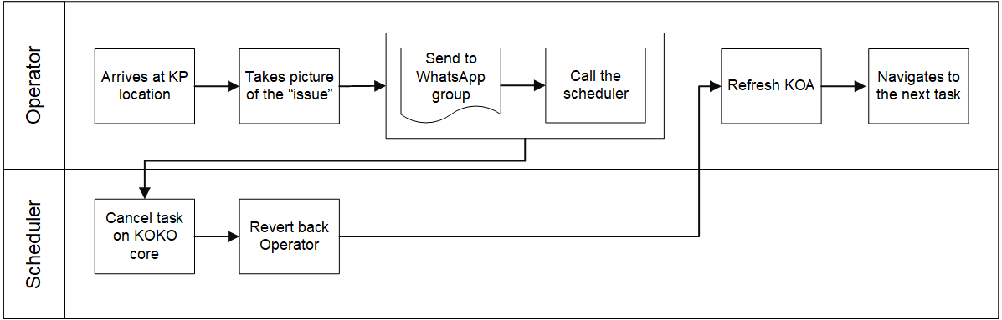
Current process of cancelling the task
This process typically takes anywhere between 5 and 30 minutes

Slide 4
Required Solution
As an operator, I need to be able to skip a task for a closed shop if the shop is closed : a. We should only allow this if the person is within the shop geofence (same as the one for the refill box opening)
b. We should capture heartbeat details at that time for the shop (mostly interested in the PIR sensor reading)
c. The operator is required to take a photo of the closed shop
d. The task will be cancelled and the reason will be captured
As an operator, I need to be able to skip a task because I can’t safely access the KP refill box:
a. We will require the operator to take a photo of blockage/hindrance before we close the task
b. The task will be cancelled and the reason will be captured

Slide 5
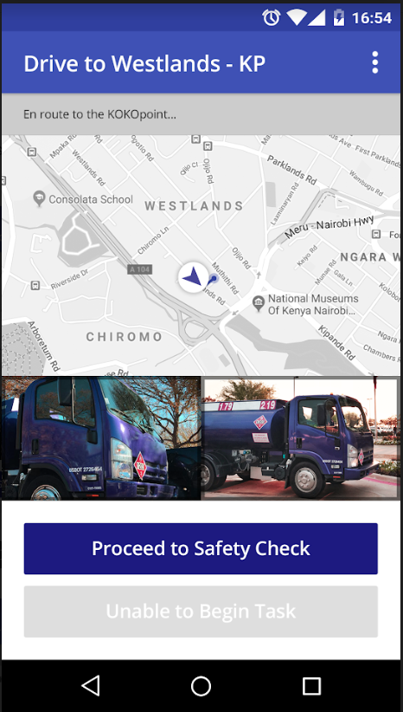
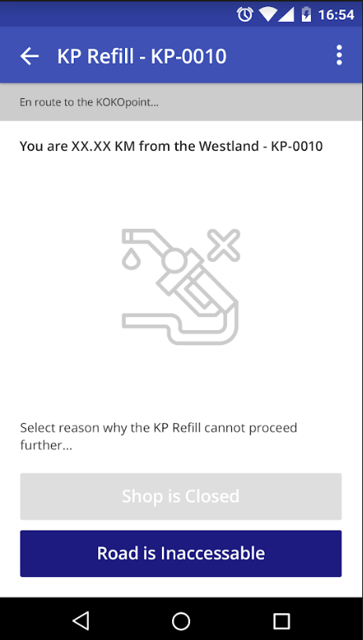
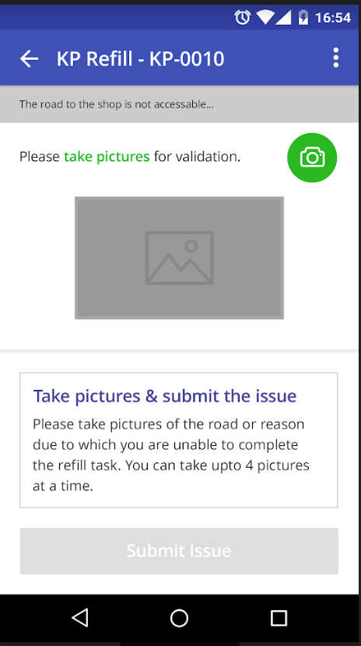
KOA app changes

Slide 6
High level design doc
https://kokonetworks.atlassian.net/wiki/spaces/DR/pages/1888026645/Skip+Task+from+KOA

Slide 7
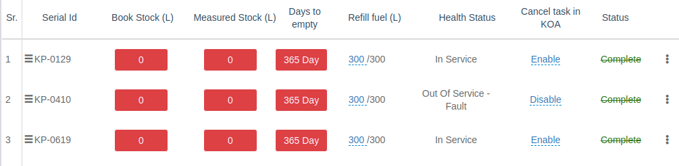
KOKO Core Changes
3. As a fuel logistic manager, I want to specify that the certain task can not be skipped/cancelled by operator from the phone.
Dfdfdfdfdd
This information is provided using end point /koa/refill/task/active
API response change :
Add column is_koa_cancellable type Boolean in
Fuel_point_refuel_task table.
/koa/refill/task/active | {‘is_koa_cancellable’: True}

Slide 8
Cancel Task from KOKO core
Add new endpoint for cancellation of the task from KOA app
Images will be uploaded on s3 (to koko-media) and url link added in cancellation_attachments field
in fuel_point_refuel_task table
/koa/update-refill-task | request should be in form data format task_id : int, task_type : kp_refill cancel_reason : sting images : list location : string
cancellation_attachments: images:[]

Slide 9
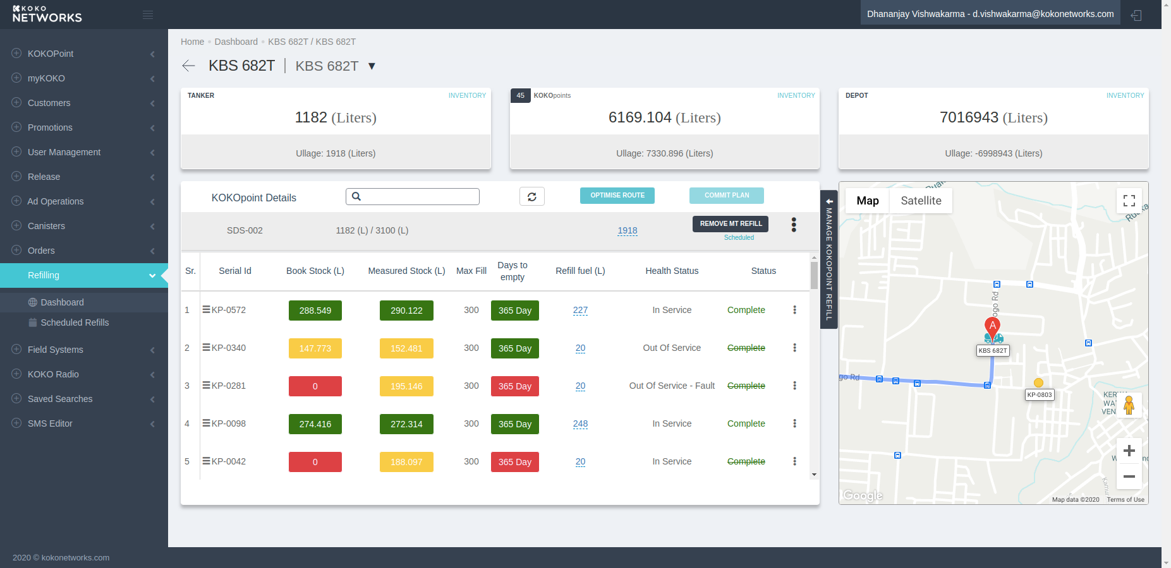
Remove Max refill from this view and it will
added in Refill fuel e.g. 217/300.
https://app.diagrams.net/#G1ZY2cv2h7pYZ06h3OoklhS6SQ3nfflU-0

Slide 10
status should be updated as completed and strike out after task cancellation.
In the task cancellation report, if last http_request_received under 5 mins so PIR sensor will update as Active in task.
PIR sensor will update as In-active if heartbeat is not under 5 min time frame and
if fuel_point_status record is not found then it will update status as Unknown.
task_metadata | {‘pir_sensor’:string, cancellation_koa_location: ‘longitude , latitude’, cancellation_time: datetime}

Slide 11
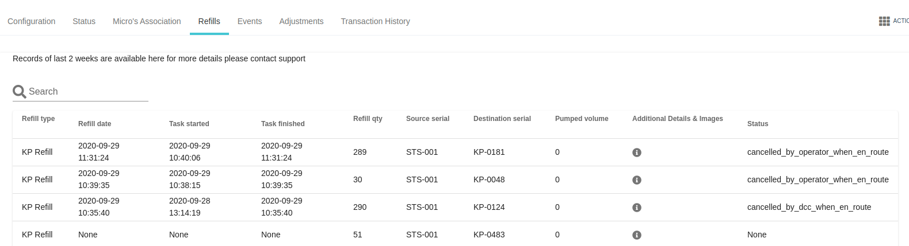
4. As the fuel logistic manager, I want to view the submitted photos to audit the legitimacy of the issue reported.
Add information icon
create popup modal to show additional
information cancel images stored in s3 bucket.

